Slide 1
Operational Dispersion Predictions at NOAA and Development of Aerosol Capabilities for the Next Generation Global Prediction System (NGGPS)
Ivanka Stajner
National Weather Service
19th Annual GMU Conference on Atmospheric Transport and Dispersion Modeling, George Mason University, Fairfax, VA
June 9, 2015

Slide 2
NOAA operational predictions of atmospheric dispersion
Routine predictions:
Smoke predictions nationwide http://airquality.weather.gov/
Dust predictions over contiguous 48 states (CONUS) http://airquality.weather.gov/
CTBTO on-demand backtracking capability
Incident support:
Volcanic ash
Radiological contamination
Chemical releases
All the above dispersion applications rely on HYSPLIT model.
Development of fine particulate matter predictions:
Wildfire smoke sources and dust sources are now included in CMAQ model

Slide 3
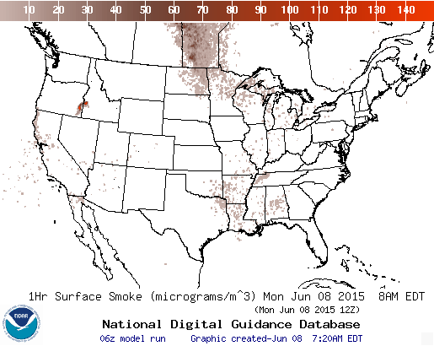
Smoke Predictions
Operational Predictions at http://airquality.weather.gov/
Smoke predictions for CONUS (continental US), Alaska and Hawaii
NESDIS provides wildfire locations
Emissions estimates from USFS Bluesky system (Testing updated version)
HYSPLIT model for transport, dispersion and deposition (Rolph et. al., W&F, 2009)
Recent updates include increased plume rise, decreased wet deposition, changes in daily emissions cycling
Developed satellite product for verification (Kondragunta et.al. AMS 2008)

Slide 4
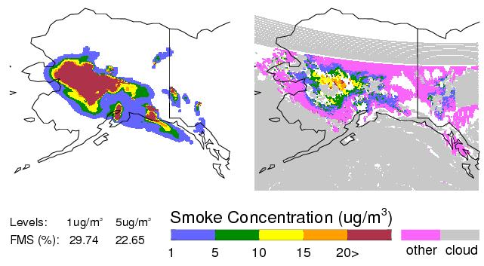
Smoke Verification using Satellite Data
July 13, 2009 example
7/13/09, 17-18Z, Prediction:
7/13/09, 17-18Z, Observation:
GOES smoke product: Confirms areal extent of peak concentrations
FMS = 30%, for column-averaged smoke > 1 ug/m³
Manuscript about smoke verification product is in preparation
4

Slide 5
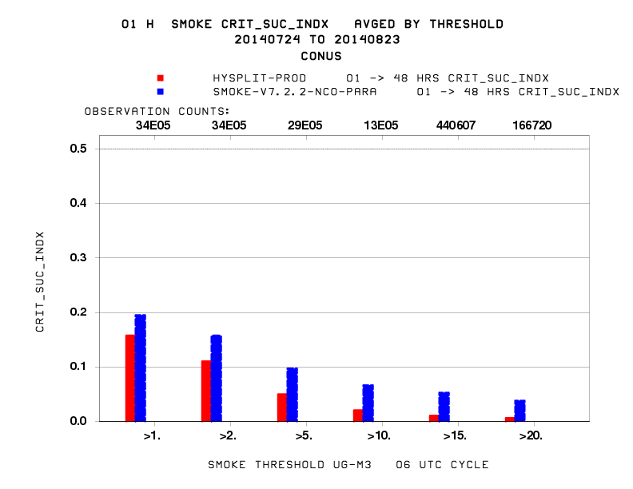
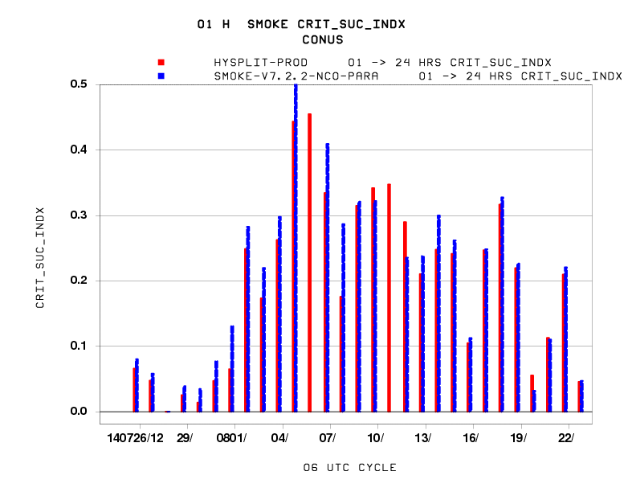
Canada/ Mexico Emission impact
July –August, 2014 CONUS CSI verification
Improved performance (higher CSI for all thresholds) of the updated smoke predictions with new Canadian and Mexican emissions

Slide 6
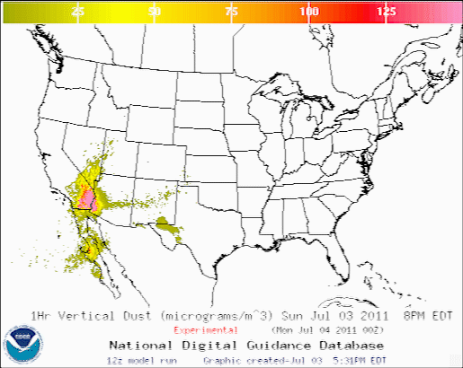
CONUS Dust Predictions
Operational Predictions at http://airquality.weather.gov/
  Standalone prediction of airborne dust from dust storms:
  Wind-driven dust emitted where surface winds exceed thresholds over source regions
  Source regions with emission potential estimated from MODIS deep blue climatology for 2003-2006 (Ginoux et al. JGR 2010)
  Emissions modulated by real-time soil moisture.
  HYSPLIT model for transport, dispersion and deposition (Draxler et al., JGR, 2010)
  Wet deposition updates in July 2013
  Developed satellite product for verification (Ciren et.al., JGR 2014)

Slide 7


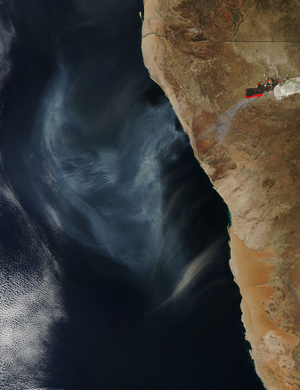
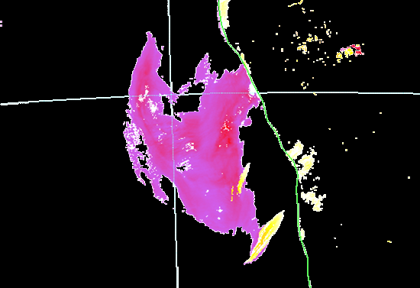
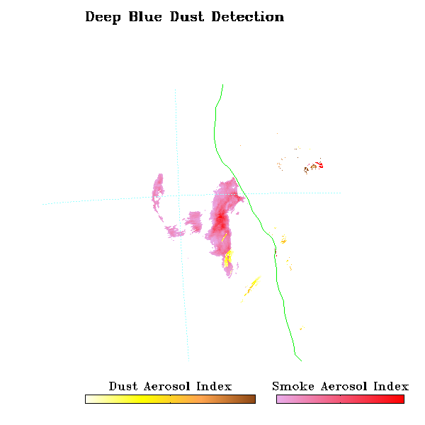
VIIRS Dust and Smoke Detection for
Air Quality Forecast Applications
DAI = -100*[log₁₀(R_{412nm}/R_{445nm})-log₁₀(R’_{412nm}/R’_{445nm})]
NDAI = -10*[log₁₀(R_{412nm}/R_{2.25um})]
Dust Aerosol Index and
Non Dust (smoke) Aerosol Index
in preoperational real time testing
at NOAA/NESDIS/STAR
VIIRS RGB

Slide 8
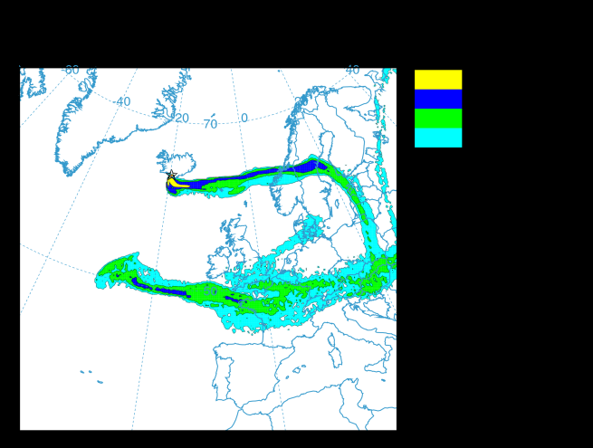
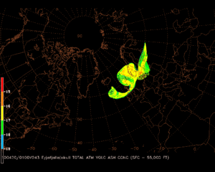
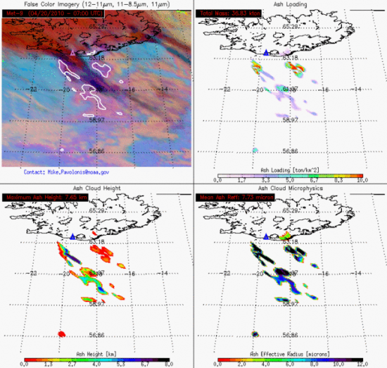
NOAA’s Volcanic Ash Assets
Response to the Eruptions of Eyjafjallajokull Volcano
NESDIS (Satellite imagery resources – top and horizontal extent of cloud)
Washington and Anchorage VAACs (detection/tracking, forecasting)
NWS/OAR (HYSPLIT) - Stunder, B., J. Heffter, R. Draxler (2007), Airborne Volcanic Ash Forecast Area Reliability, Weather and Forecasting, 22:1132-1139, DOI: 10.1175/WAF1042.1
Meteorological Watch Offices (Aviation Warnings for Volcanic Ash – SIGMETs)
  NWS/NCEP Aviation Weather Center
  NWS Weather Forecast Office Honolulu
  NWS Alaska Aviation Weather Unit
Center Weather Service Unit (1 per FAA Air Route Traffic Control Center)
NOAA’s Volcanic Ash Program

Slide 9
Dispersion of radioactive material
NOAA is the home for the U.S. Regional Specialized Meteorological Center under WMO that supports International Atomic Energy Agency (IAEA)
For the Fukushima Daiichi's nuclear power plant incident:
  IAEA requested NOAA transport simulations, which were shared with IAEA member countries.
  NOAA worked with DOE to inform the federal community about the transport of radiation. NOAA also responded to requests for support from multiple agencies.
  NOAA atmospheric modeling group provided estimates of deposition into the ocean for NOAA’s ocean radiation simulations.
  HYSPLIT runs were used for these simulations (NOAA/ARL, NOAA/NCEP).
  NOAA developed an approach for quickly updating predictions or evaluating multiple emissions scenarios. Draxler & Rolph (2012) J. Geophys. Res., 117, D05107, doi:10.1029/2011JD017205.
UNSCEAR 2013 Report:
  NOAA provided calculations of air concentration and deposition that were used by other experts to estimate radiation doses.
  The NOAA dispersion model, HYSPLIT, and meteorological data from NCEP were extensively used in the Committee’s evaluation.
  Additional radiation dose for majority of people in Japan and for people in neighboring countries is less than typical yearly amount of natural background radiation.
  UNSCEAR 2013 Report Vol 1: Sources, Effects and Risks of Ionizing Radiation, Scientific Annex A.

Slide 10
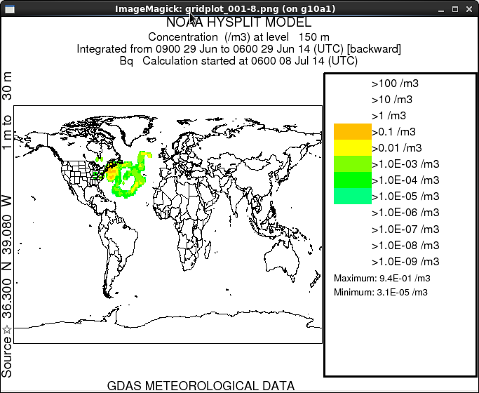
CTBTO Backtracking
On-demand backtracking capability is operationally implemented by NOAA to provide potential source locations to the Comprehensive Nuclear-Test-Ban Treaty Organization (CTBTO) per MOU with the Department of State.
Visualization: Dispersion Plot
Operational CTBTO response system was implemented in September 2014 at NCEP.
The system relies on NOAA’s dispersion model code (HYSPLIT) with backtracking capability and essential source attribution codes and scripts with integrated testing, verification and documentation.
The prototype system provides responses to CTBTO requests.
Hypothetical test example

Slide 11
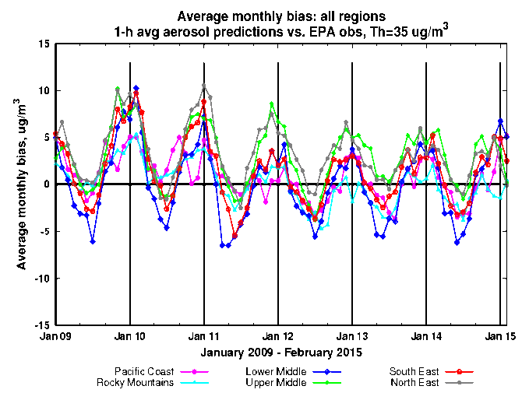
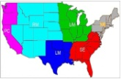
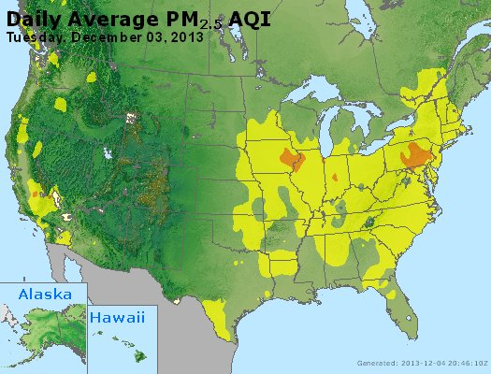
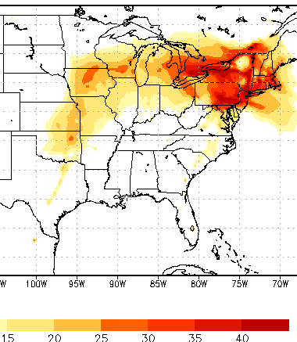
Testing of PM2.5 Predictions
  AQ Forecaster Focus group access only, real-time as resources permit
  Aerosols over CONUS
    From NEI sources only before summer 2014
    CMAQ:
    CB05 gases, AERO-4 aerosols
    Sea salt emissions
  Show seasonal bias-- winter, overprediction; summer, underprediction
Forecast challenges
Improving sources for wildfire smoke and dust – in testing since summer 2014
Chemical mechanisms eg. SOA
Meteorology eg. PBL height
Chemical boundary conditions/trans-boundary inputs
NAQFC PM2.5 test predictions

Slide 12
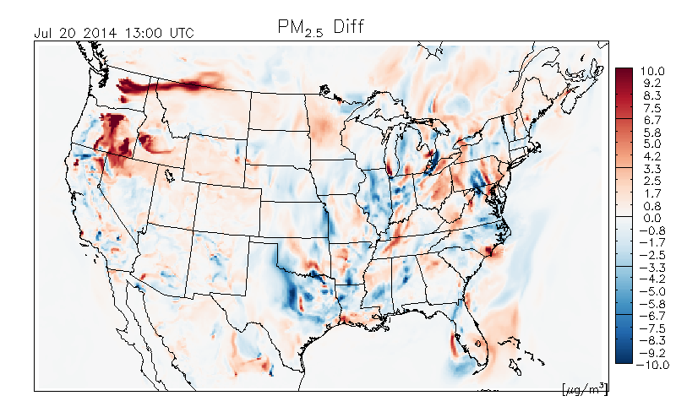
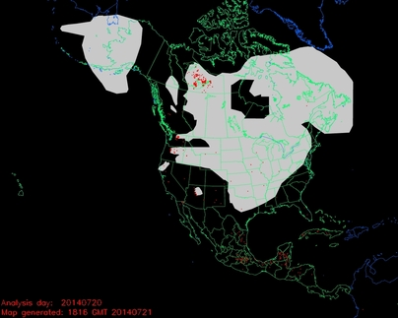
Impact of forest fires in
testing of PM2.5 predictions
Difference between two PM2.5 predictions:
with-minus-without fire emissions
NOAA NESDIS Hazard Mapping System Fire and Smoke Analysis
Detection of wildfire locations from satellite imagery

Slide 13
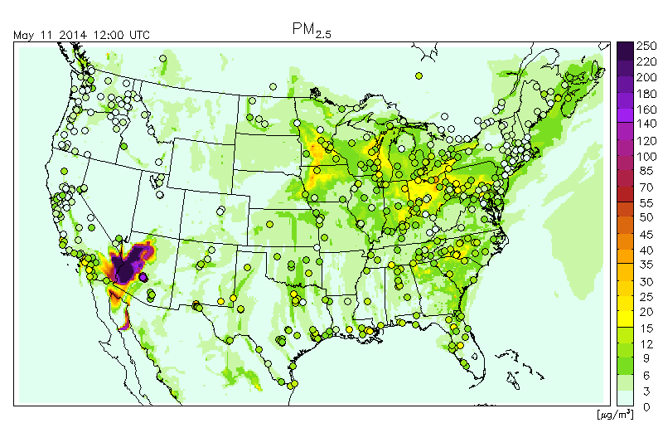
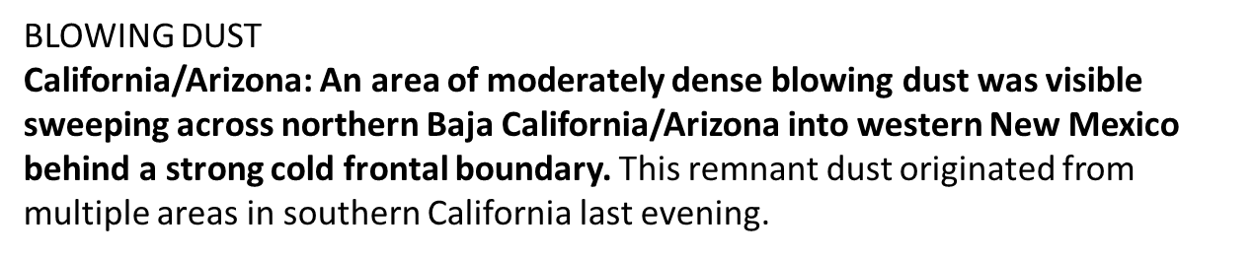
Blowing Dust Event in testing of PM2.5 predictions
Independent
NOAA/NESDIS
analysis narrative
based on
satellite imagery:

Slide 14
Next Generation Global Prediction System (NGGPS)
Design, develop, and implement the NGGPS in 2019 to
    Extend forecast to 30 days
    Incorporate atmosphere, ocean, ice, land surface, waves, and aerosol model components
    Fully couple the system using NEMS/ESMF
Fully utilize evolving high performance computing (HPC) capabilities
5-year community effort
    Contribute to NGGPS development
    Model components available as community code
NGGPS website: http://www.nws.noaa.gov/ost/nggps
Notes:
A research to operations (R2O) initiative is underway to design, develop and implement the Next Generation Global Prediction System (NGGPS) by 2019.
This will be a fully coupled system to extend useful forecast skill to 30 days. This system will be designed to utilize new high performance computing capabilities.
This is not just an NWS effort, it is a community effort with participation of NOAA and other federal laboratories and universities.
For example, the new dynamical core for NGGPS will be selected from several dynamical cores undergoing testing and evaluation. These dynamical cores are provided by: NCAR, NOAA/GFDL, NOAA/ESRL, Navy and NOAA/NWS/EMC.

Slide 15
NGGPS Prediction Model Components
Atmospheric Components
Atm Dycore
(TBD)
Atm Physics
(GFS)
Aerosols
(GOCART)
Atm DA
(GSI)
NEMS/ESMF
Land Surface
(NOAH)
Ocean
(HYCOM)
(MOM)
Wave
(WW3)
(SWAN)
Sea Ice
(CICE/KISS)
NGGPS implementation plan development includes an aerosol team
Development of dust/aerosol capabilities is underway by universities and federal labs
Notes:
NGGPS prediction model will consist of fully coupled components representing different parts of the Earth system. All components will be based on community codes.
Dynamical core testing and selection is on progress.
Atmospheric aerosol component improvement is underway.

Slide 16
NGGPS Dust/Aerosol
Development in Progress
Paul Ginoux (NOAA GFDL)
  Implementation and Testing of Regional and Global Dust Forecasting
Sarah Lu (SUNY Albany)
  Investigation of Aerosol Effects on Weather Forecast using NCEP Global Forecast System – radiative effects
  Improving Cloud Microphysics and Their Interactions with Aerosols in the NCEP Global Models
Georg Grell (NOAA/ESRL/GSD)
  Using Advanced Photochemical and Aerosol Modules to Verify the Applicability of GOCART Aerosol Modules within Global Weather Prediction Models
Zhanqing Li (Univ. of MD)
  Evaluating the Impact of Cloud-Aerosol-Precipitation Interaction (CAPI) Schemes on Rainfall Forecast in the NGGPS
Notes:
These are currently funded grants to universities and federal laboratories for development of dust/aerosol components for NGGPS and evaluation of aerosol interactions with radiation, cloud microphysics and precipitation.
Ginoux - Dust sources inventory, dust simulation/forecasting, and model evaluation
Sara Lu – 1) Aerosol Effects
-Modify radiation package so aerosol optical properties and radiative effects can be determined
-Evaluate NCEP RTG_SST analysis system with the aerosol option incorporated, and assess the impact of aerosols on SST analysis in situ observations
2) Cloud microphysics - improving the representations of cloud microphysics, aerosol processes, and aerosol-cloud-radiation interactions in the NCEP global model
Grell -Use gas-phase and aerosol chemistry packages with different levels of sophistication in state-of-the-art global modeling systems
-Determine the degree of complexity necessary to estimate the impact of aerosols on numerical weather prediction skill
Li – Evaluate the performance of the new physical schemes associated with accounting for the aerosol effects, and understanding the causes of discrepancies in simulating clouds and their interactions with aerosol

Slide 17
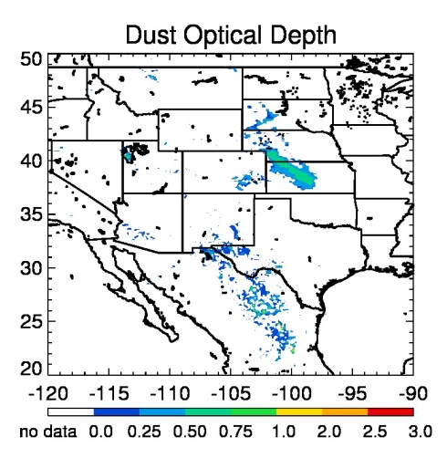
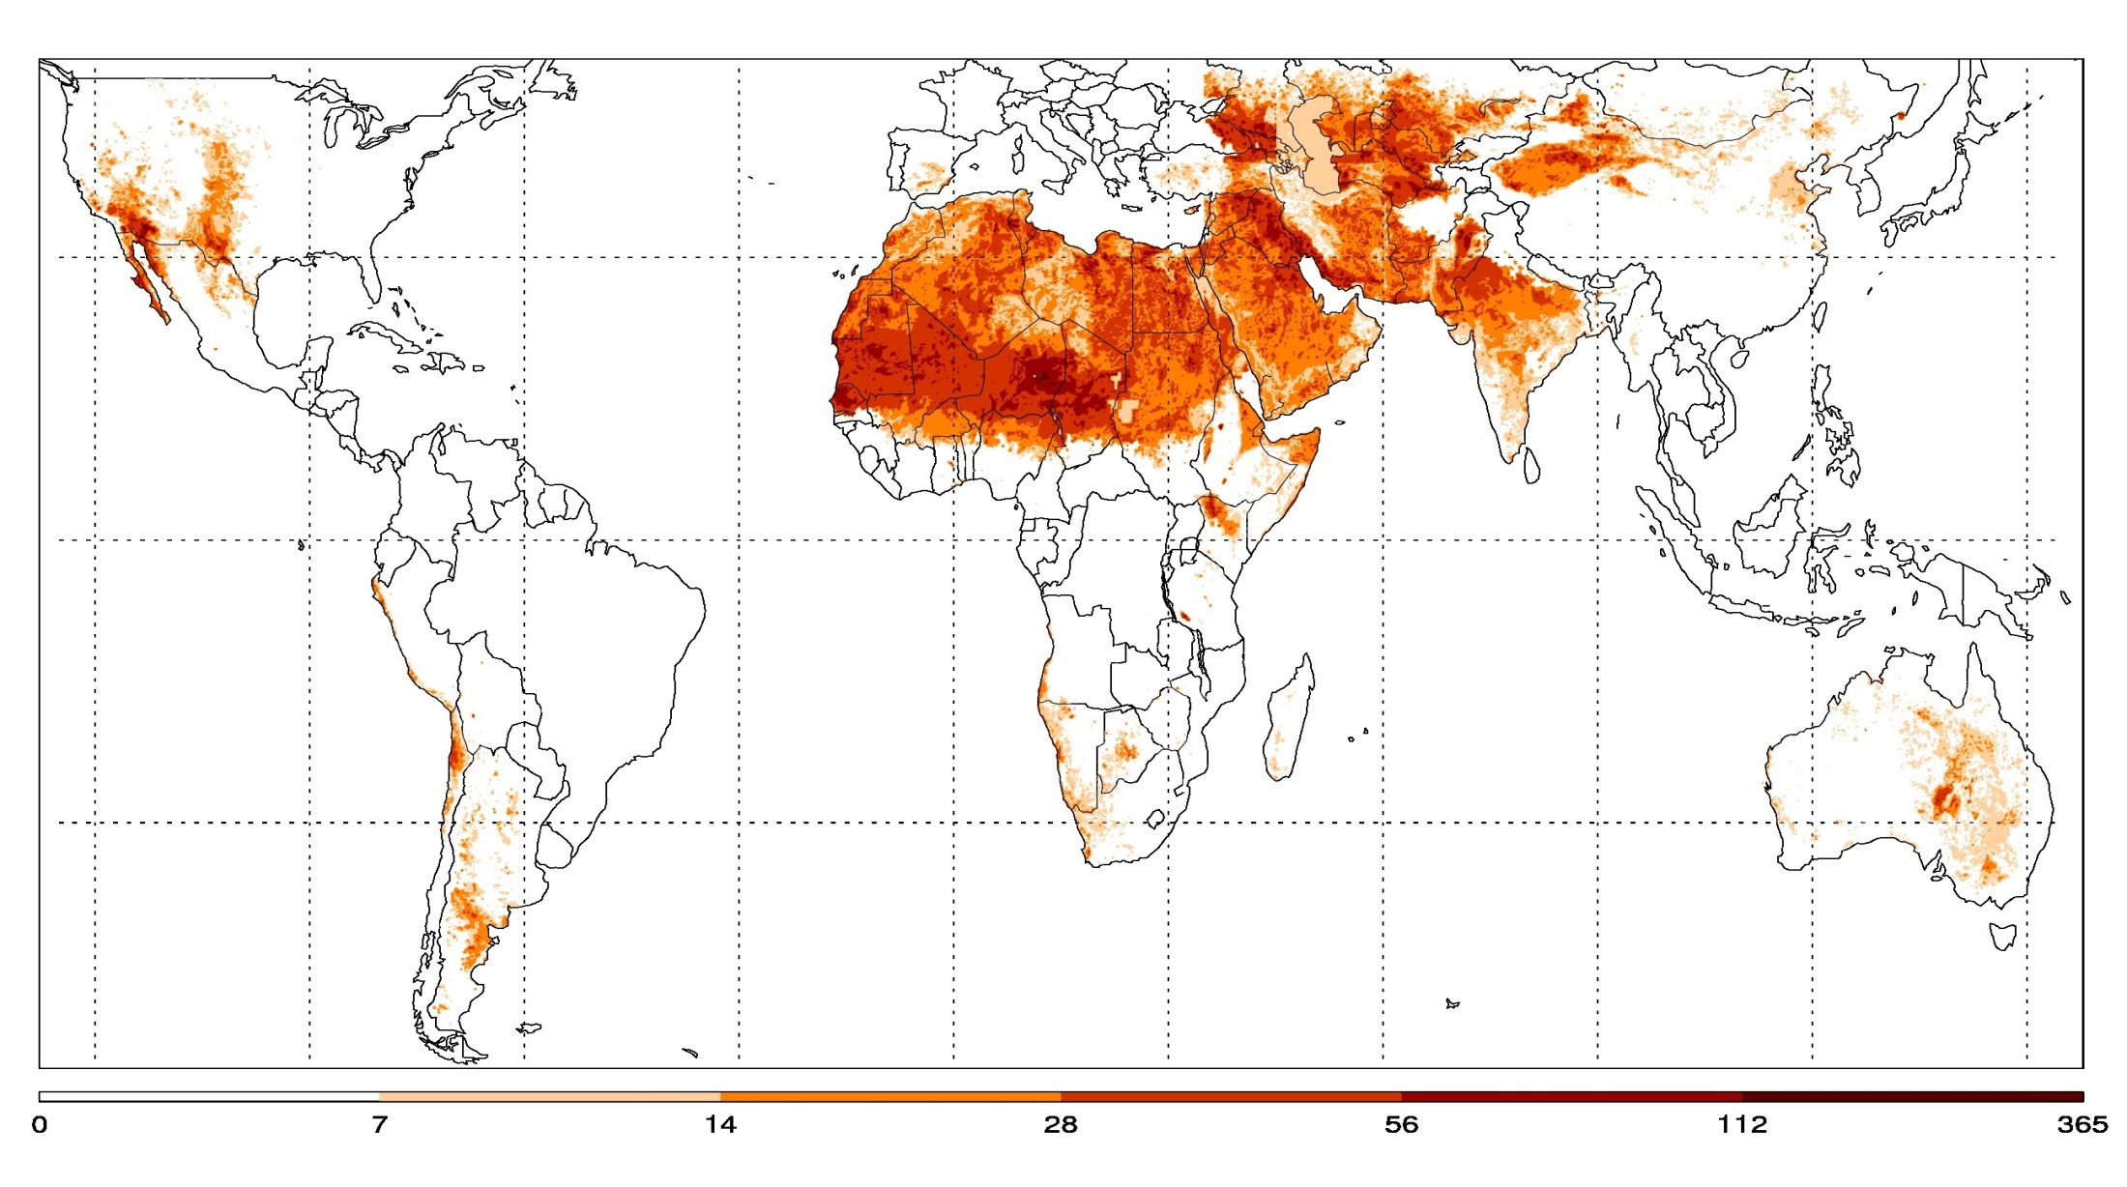
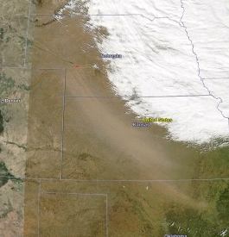
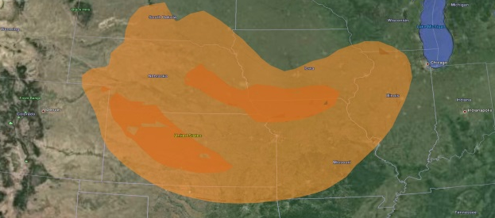
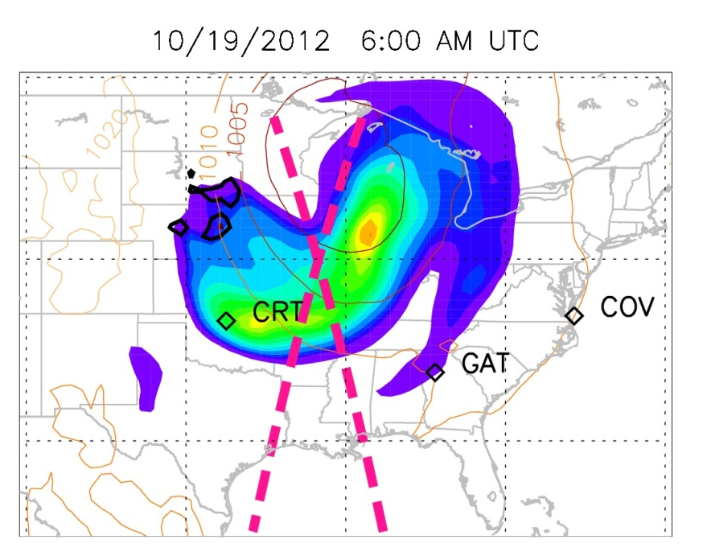
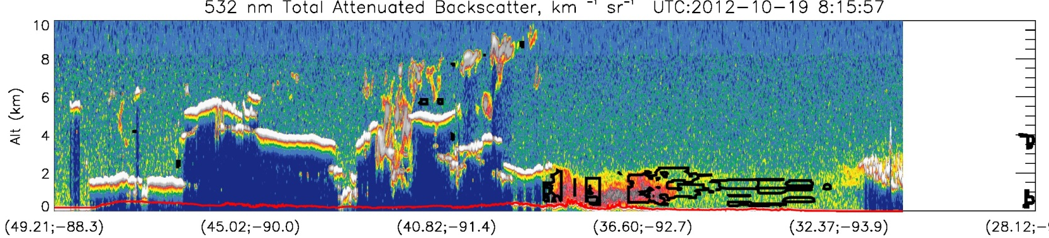
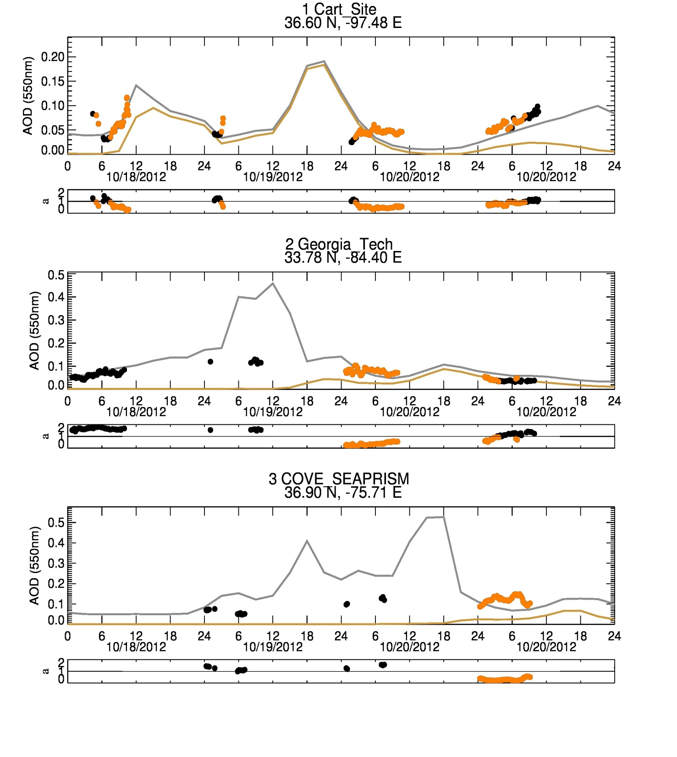
Implementation and testing of regional and global dust forecasting
NOAA NGGPS project
PI: Paul Ginoux (NOAA GFDL)
1. Dust Sources Inventory
Dust detection using MODIS satellite at 0.1º resolution (~10 km) daily for 12 years (2003-2014). Dust source = location of the most frequent dust events (Ginoux et al., Rev. Geophys., 2012). Unique global high resolution dust sources inventory.
One granule of satellite pixels at a time from regional to global, daily and for 12 years of newly released MODIS data
2. Dust Simulation/forecasting
Dust simulation with NMMB for one year (2012), global and CONUS (high resolution)
Dust events are frequent in the High Plains, creating deadly accident, shutting Interstate Highways, such as in October 2012.
3. Model Evaluation
Evaluation and skill scores using ground-based and satellite data
CALIPSO lidar
AERONET sunphotometer
Notes:
Ginoux 1 of 2

Slide 18
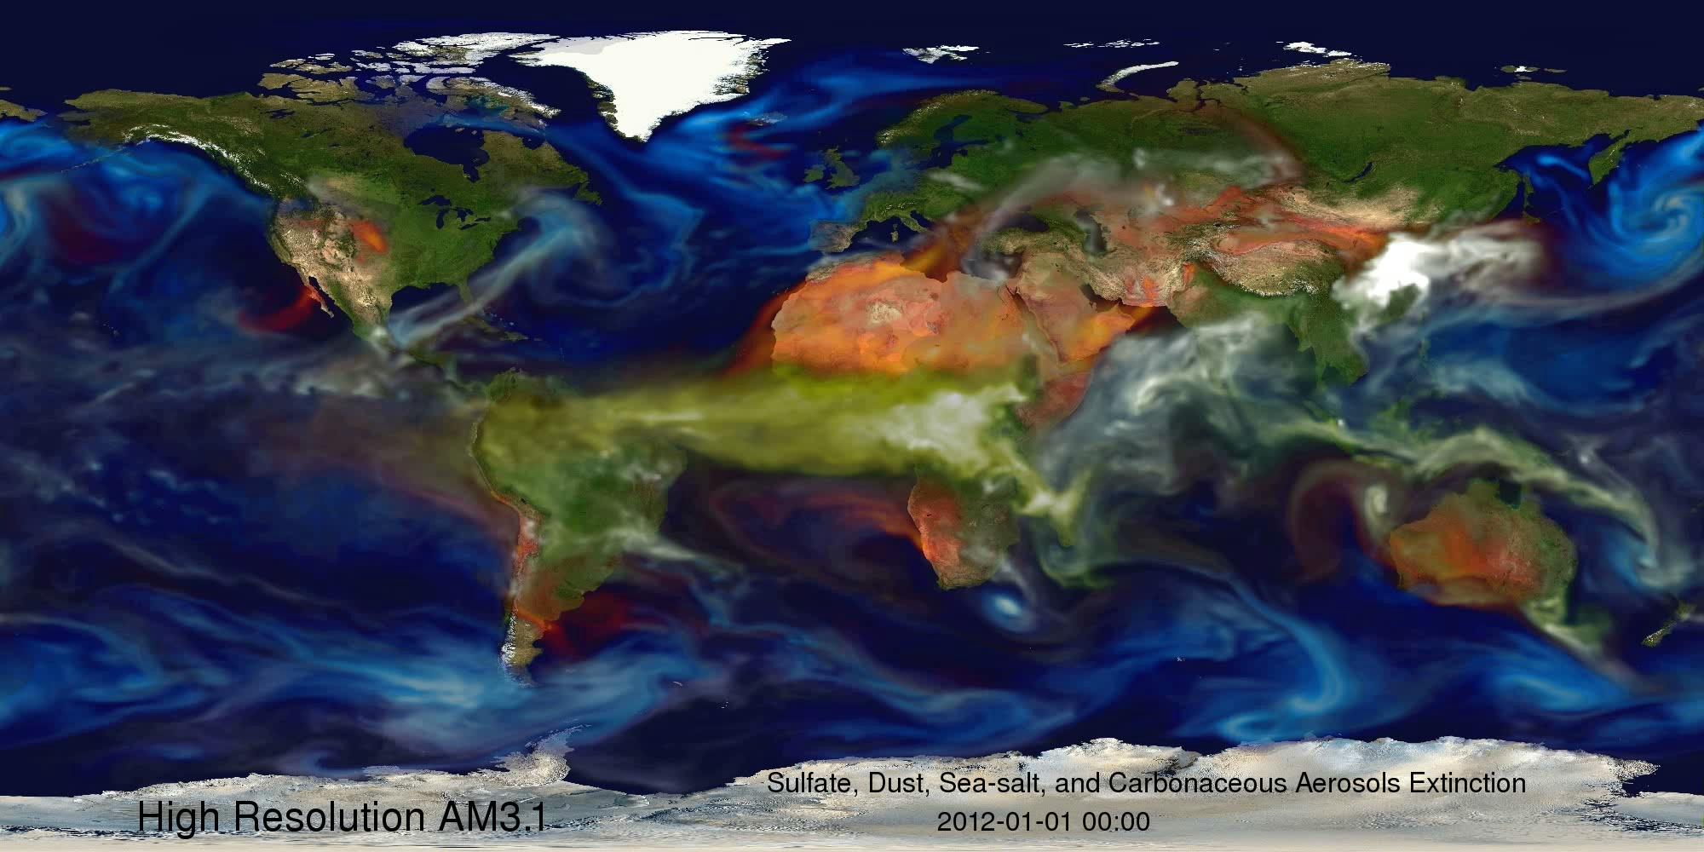
Notes:
Ginoux 2 of 2

Slide 19
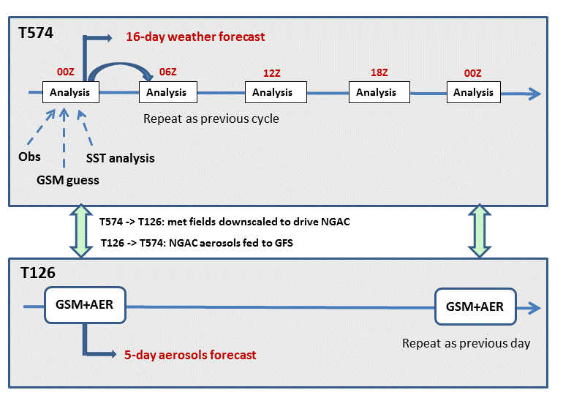
Investigation of Aerosol Effects on Weather Forecast using NCEP Global Forecast System
PI: Sarah Lu, University at Albany, State University of New York (SUNYA)
Project goal: Explore the optimal configurations for the GFS to represent aerosol processes. Year 1 plans include:
Upgrade the infrastructure in the dual resolution system, allowing NGAC aerosol fields fed into GFS
The radiation package in GSM will be modified so aerosol optical properties can be determined from GOCART aerosol species taken from external NGAC output files (the loose coupling option) or internally from 3-dimensional tracer arrays (the tight coupling option)
The GSI/CRTM code will be modified so aerosol radiative effects can be determined from aerosol fields from external low-resolution NGAC files (the loose coupling option) or from prognostic aerosol fields in GSM guess files (the tight coupling option)
GFS parallel scripts will be modified to enable two-way coupling (the loose coupling option)
Evaluate NCEP RTG_SST analysis system with the aerosol option incorporated.
RTG_SST analysis with and without considering aerosol attenuation will be generated, and the impact of aerosols on SST analysis will be assessed using in situ observations
An enhanced dual resolution system, allowing aerosol information from low resolution NGAC to be fed into high resolution GFS.

Slide 20
Using advanced photochemical and aerosol modules to verify the applicability of GOCART aerosol modules within global weather prediction models
Georg A. Grell (NOAA/ESRL/GSD) and Stuart A. McKeen (NOAA/ESRL/CSD)
Use gas-phase and aerosol chemistry packages with different levels of sophistication in state-of-the-art global modeling systems
Determine the degree of complexity necessary to estimate the impact of aerosols on numerical weather prediction skill
Deliverables will include chemistry and aerosol packages for inclusion in any NGGPS modeling system as well as scientific publications
ECMWF
JMA
For NGGPS this will accelerate development and implementation of weather prediction model components (aerosol models), and improve coupling between the component model systems
The evaluated chemistry and aerosol packages can be included in any of the NGGPS modeling systems
Improvement when including aerosols for near surface temperature predictions as shown by a Working Group for Numerical Experimentation and a model intercomparison case over Brazil. Examples from 2 operational center models include radiation interaction (direct effect) and microphysics interaction (indirect effect). “No aeroso” runs were done with climatologies

Slide 21
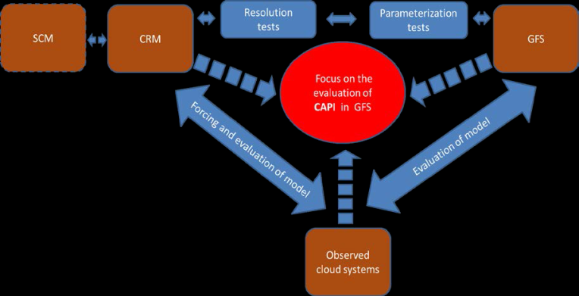
Evaluating the Impact of Cloud-Aerosol-Precipitation Interaction (CAPI) Schemes on Rainfall Forecast in the NGGPS
Principal Investigator: Zhanqing Li - ESSIC, University of Maryland
Co-Principal Investigator: Seoung-Soo Lee - ESSIC, University of Maryland
Co-Investigators: Yu-Tai Hou, Jun Wang, Shrinivas Moorthi - NOAA/NCEP/EMC
Sarah Lu - SUNY Albany
Approach to evaluate schemes:
Evaluating the performance of the new physical
schemes associated with accounting for the aerosol
effects that affect rainfall forecasts and cloud
simulations through in-depth comparisons with
extensive global satellite and ground-based products
And observation-based findings
Understanding the causes of discrepancies in simulating
clouds and their interactions with aerosol between current and new schemes, and between model simulations and observations by virtue of a high-resolution cloud-resolving model (CRM)
An integrated approach to evaluate the GFS model regarding CAPI by using CRM, SCM, and observations.
Improving the physical parameterizations of cloud-aerosol interactions allows for efficient, accurate and more complete representations of physical processes and their interactions across scales

Slide 22
Summary
Operational predictions of atmospheric dispersion
NOAA provides smoke predictions nationwide, dust predictions for CONUS, and an on demand back-tracking capability for CTBTO
NOAA provides incident support for volcanic ash, radiological contamination and chemical release dispersion
HYSPLIT model
Development of fine particulate matter predictions for the US
Wildfire smoke sources and dust sources are included in CMAQ model
Linkage with global dust/aerosol predictions
Next generation global prediction system (NGGPS)
Improved aerosol modeling and coupling with atmospheric radiation and microphysics

